Slide 1
Templates
Creative Commons Attribution-NonCommercial-ShareAlike 3.0 Unported License. http://creativecommons.org/licenses/by-nc-sa/3.0/
Written by Rachel J. Morris, last updated 2016-04-16

Slide 2

One size fits all*
* may not fit all, not legally responsible for lack of fit

Slide 3

Overloading for same functionality
Currently, we can utilize function overloading so that we can have multiple functions with the same name and different parameter list.
This might be useful if we want to be able to use the same functionality for different data-types.

Slide 4
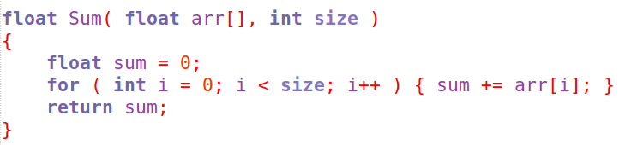
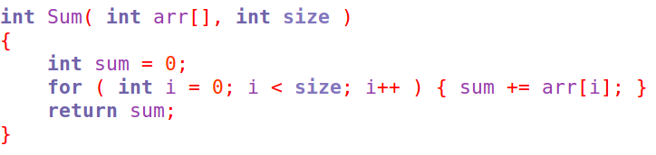
Overloading for same functionality
But in some cases, this means duplicating some code...
So can we write the function once, and use it with any data-type?

Slide 5
Function Templates

Slide 6
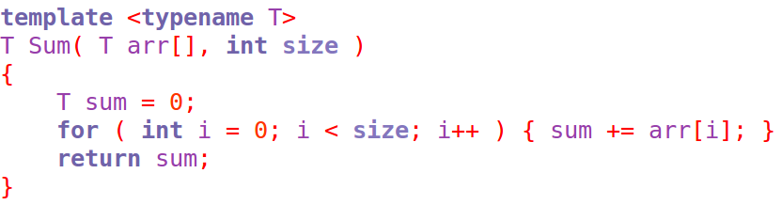
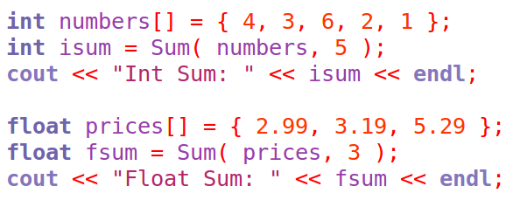
Function Templates
* note for this example, all data-types passed in must have operator+ overloaded to work.
By utilizing templates...
… we can make a function that will handle any* data-type

Slide 7
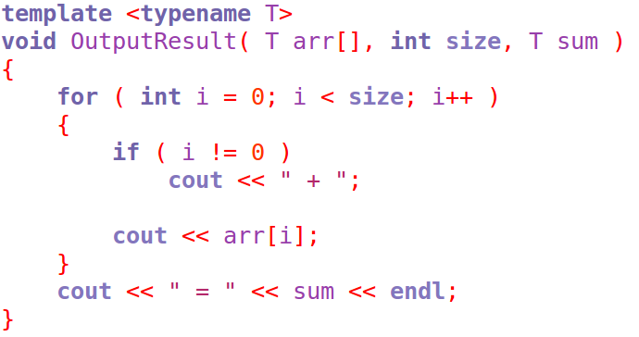
Function Templates
To create a function that uses a template to be a “placeholder” for a variable's data-type, we need to prefix the function with the
template prefix:
Template <typename T>
You can put anything you want in place of “T”, but T is the standard in much of the code that you will see.

Slide 8
Function Templates
Second, you will use “T” in place of the data-type that would change.
Note that you can still have hard-coded data-types in the parameter list and as local variables in the function.
Template
Not a template
Template

Slide 9
Function Templates
As long as the variable passed into the template has all the needed functionality that is used within the function, it should be O.K.
For this function, any data-types that T represents must have operator<< overloaded.

Slide 10
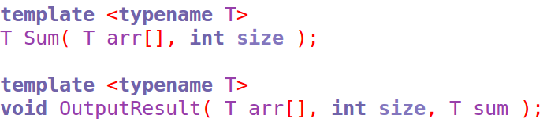
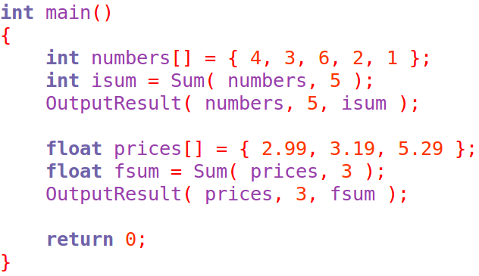
Function Templates
Then, calling the functions is simple – it looks like any other function call.

Slide 11
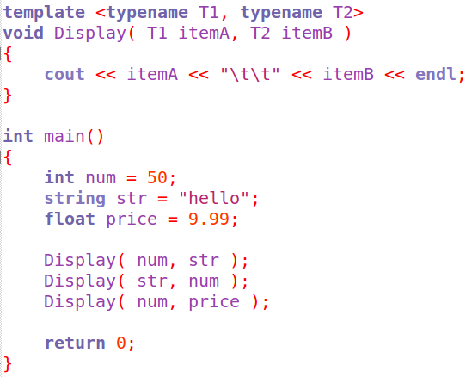
Function Templates
You can also have multiple type parameters as well, if you require different data-types that are not hard-coded.

Slide 12
Class Templates

Slide 13

Good news, everyone!
Templates can also be
used with classes!

Slide 14


Class Templates
Templates can also be used with classes in order to build more complex structures.
For example: A class that contains a dynamic array, and handles the memory management and resizing functionality internally.
By making it a template, we only need one “Dynamic Array” object, for any data-type!
Sound familiar?

Slide 15
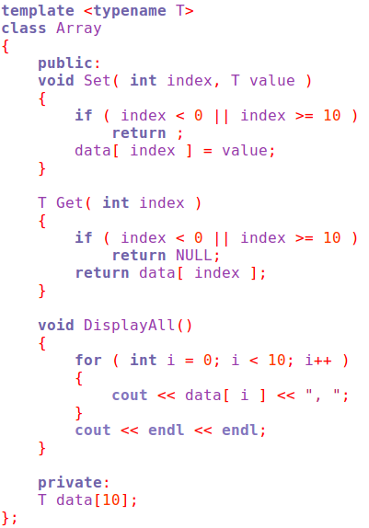
Class Templates
Similar to with a function template, we start with the template prefix.

Slide 16
Class Templates
Then, anywhere we use this “type” within the class, we use T.
And we write the rest of the functionality normally.

Slide 17
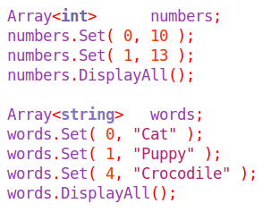
Class Templates
When we declare a variable using this class, we must specify the type within < and > signs.
Then we simply call the functions and pass in the data-type we need.

Slide 18

But keep in mind...

Slide 19
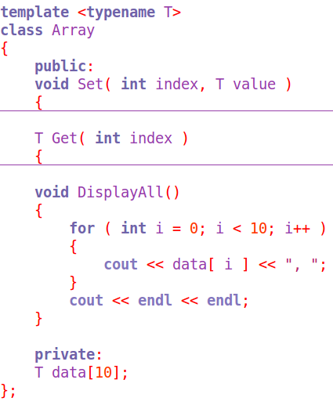
Definitions in the class...
When you view classes using templates written by other people, you might notice that the function definitions tend to be stored within the class declaration, all in one .h or .hpp file.
Different compilers may handle templates differently, but this is the safest thing to do – include the entire class and its function definitions all in one header file.

Slide 20

Definitions in the class...
There are ways to work around this, but for the time being implementing function definitions within the class declaration is generally good enough.

Slide 21

Practice!

Slide 22
Practice
Let's implement a Dynamic Array wrapper class and use templates!
Then you won't have to implement a class that takes care of memory allocation and resizing anymore, you'll already have a generic class for it! ;)
(Though really, I tend to just use std::vectors anyway)

